Slide 1




Cyber Defense
Organization
Spring 2020 - Metasploit

Slide 2
Download Global Protect now so you don't have to download it for the interactive portion later. https://tinyurl.com/uaglobalprotect

Slide 3
WORD OF THE WEEK: Exploit-DB

Slide 4

What is Metasploit???
It is a open source exploitation framework.
Rather than being a single tool (such as NMAP) it is a collection of several tools and exploits.
Is constantly evolving to keep up with enhanced security.
Is used by Cyber Security Pro’s and Ethical Hackers alike.

Slide 5

Some Good Terminology for Metasploit
Vulnerability- Weakness in a system or a bug which can be exploited.
Exploit- A Piece of code which takes advantage of a vulnerability.
Payload- Another piece of code that is implemented through a exploit, lets somebody gain control of a computer system after its been exploited

Slide 6

Why is it Useful?
Allows you to access a HUGE number of Penetration Testing Tools
Has exploits for Different Types of servers (Web, FTP, Mail) to home computers
Is Open Source and can freely be downloaded onto any linux machine.
Extreme customizability of exploits
Has many different types of Modules (See Next Slide…)

Slide 7
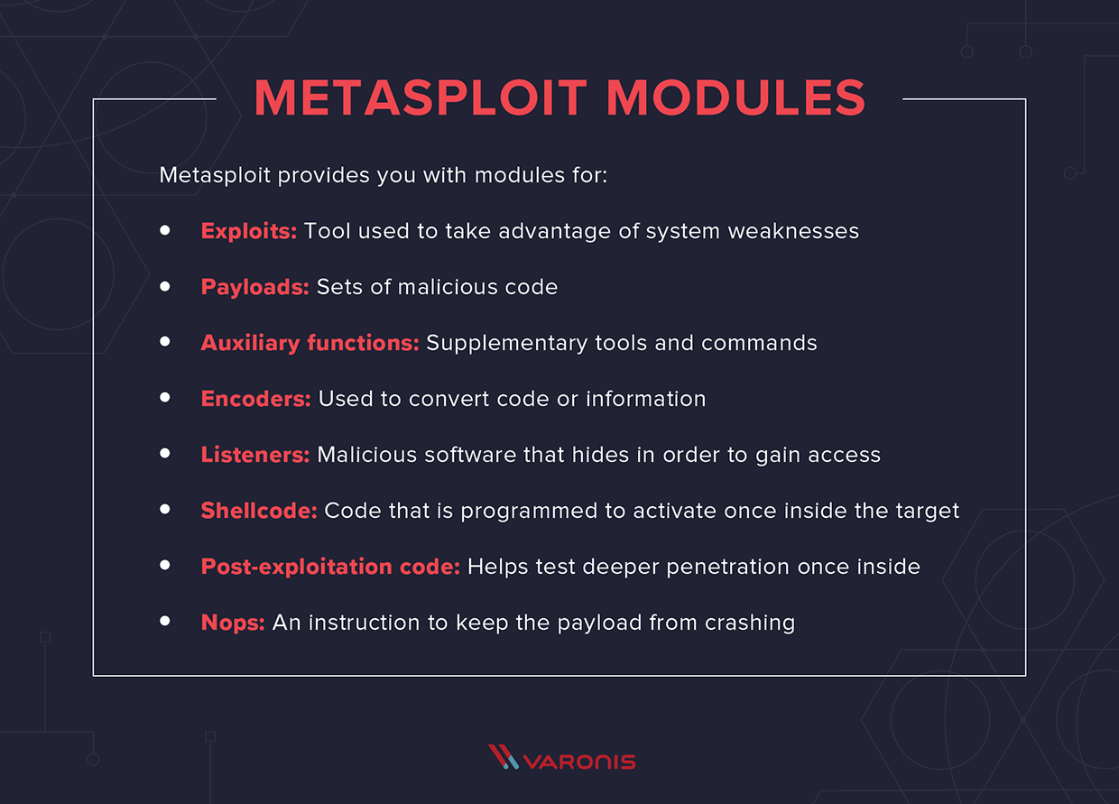

Slide 8
WHAT ARE SOME TOOLS FOUND IN METASPLOIT???

Slide 9

msfvenom
Payload generator and encoder
Allows to create payloads in .c,.exe,python, and java format.
Allows you to create malicious files that victims can initiate.

Slide 10
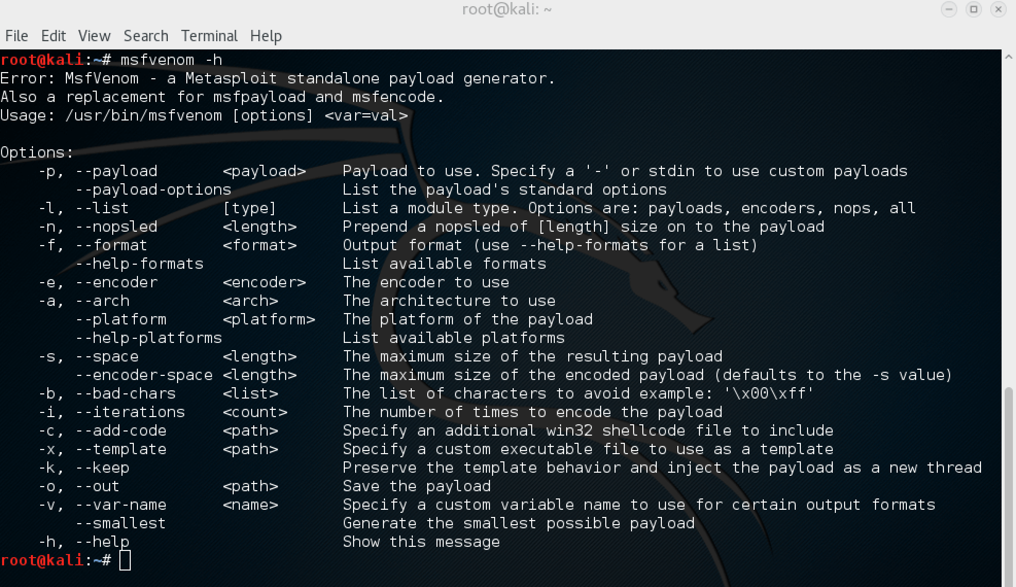

Slide 11
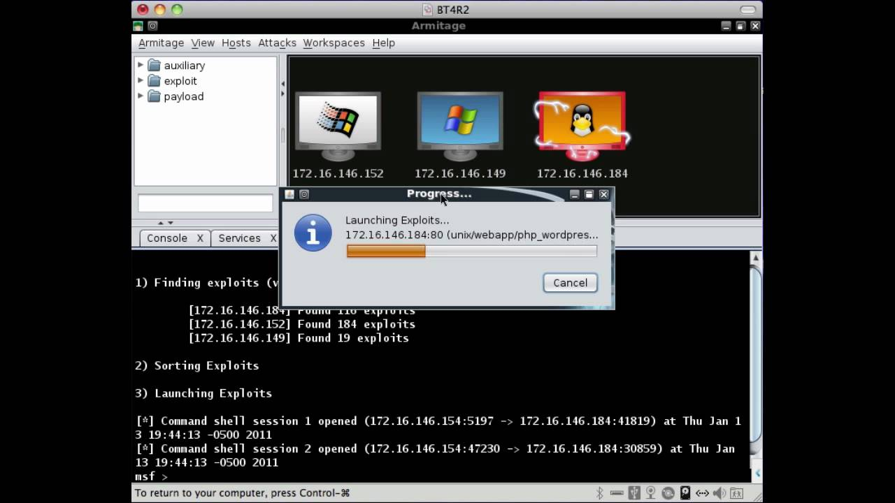

Armitage
Attack manager tool that automates Metasploit by providing a helpful GUI.
Helps by recommending exploits depending on target.
Is built on top of the Metasploit framework.
Is written in java.

Slide 12

Convenient Metasploit Commands
Here is a pdf that has a lot of good explanations on metasploit and cheatsheets on metasploit.
https://www.sans.org/security-resources/sec560/misc_tools_sheet_v1.pdf

Slide 13
Coming up next week!
Tuesday: Blue Team Practice @ 7pm
Wednesday: Security + @ 5pm
Thursday: Red Team Practice @ 7:30pm
Friday: Intro to Encryption @ 3:30pm

Slide 14
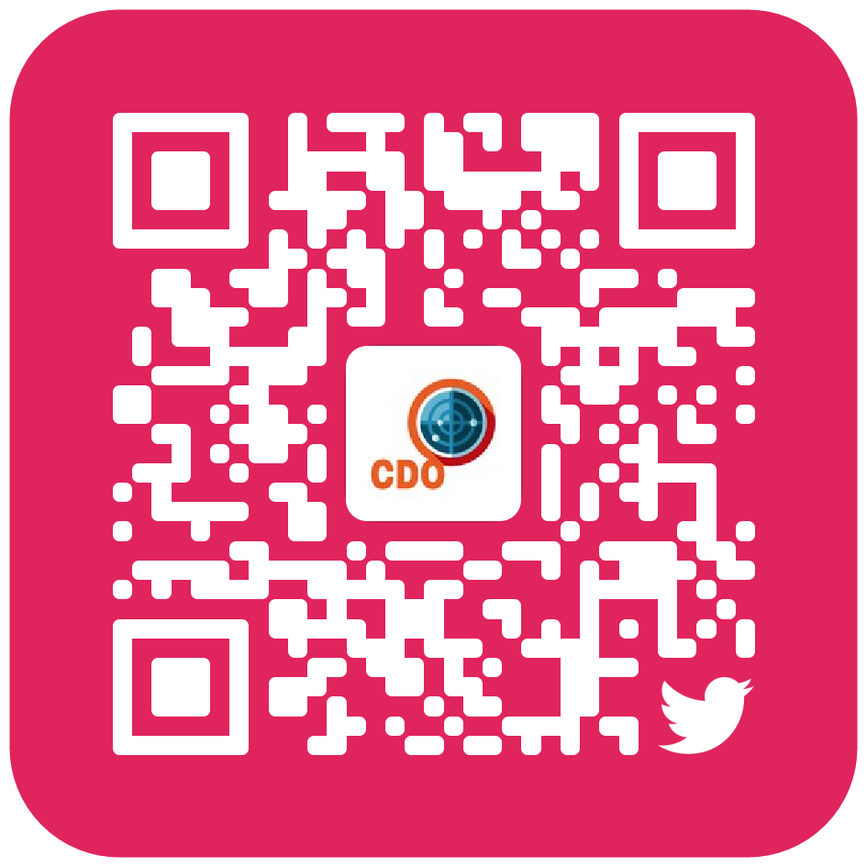


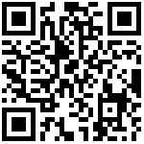

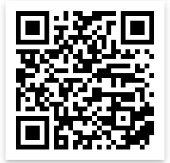
Add us on Social Media!
Twitter: @ualbanyCDO
Instagram: ualbany_cdo
Website: uacyber.org
Myinvolvement: Cyber Defense Org
We have a discord!

